Slide 1
Guide to Computer Forensics and Investigations
Third Edition
Chapter 7
Current Computer Forensics Tools

Slide 2
Objectives
Explain how to evaluate needs for computer forensics tools
Describe available computer forensics software tools
List some considerations for computer forensics hardware tools
Describe methods for validating and testing computer forensics tools
Guide to Computer Forensics and Investigations

Slide 3
Evaluating Computer Forensics Tool Needs
Look for versatility, flexibility, and robustness
  OS
  File system
  Script capabilities
  Automated features
  Vendor’s reputation
Keep in mind what application files you will be analyzing
Guide to Computer Forensics and Investigations

Slide 4
Types of Computer Forensics Tools
Hardware forensic tools
  Range from single-purpose components to complete computer systems and servers
Software forensic tools
  Types
    Command-line applications
    GUI applications
  Commonly used to copy data from a suspect’s disk drive to an image file
Guide to Computer Forensics and Investigations

Slide 5
Tasks Performed by Computer Forensics Tools
Five major categories:
  Acquisition
  Validation and discrimination
  Extraction
  Reconstruction
  Reporting
Guide to Computer Forensics and Investigations

Slide 6
Tasks Performed by Computer Forensics Tools (continued)
Acquisition
  Making a copy of the original drive
Acquisition subfunctions:
  Physical data copy
  Logical data copy
  Data acquisition format
  Command-line acquisition
  GUI acquisition
  Remote acquisition
  Verification
Guide to Computer Forensics and Investigations

Slide 7
Tasks Performed by Computer Forensics Tools (continued)
Acquisition (continued)
  Two types of data-copying methods are used in software acquisitions:
    Physical copying of the entire drive
    Logical copying of a disk partition
  The formats for disk acquisitions vary
    From raw data to vendor-specific proprietary compressed data
  You can view the contents of a raw image file with any hexadecimal editor
Guide to Computer Forensics and Investigations

Slide 8
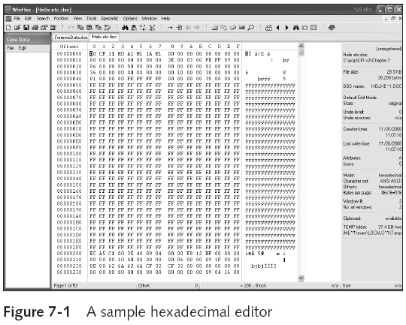
Guide to Computer Forensics and Investigations

Slide 9
Tasks Performed by Computer Forensics Tools (continued)
Acquisition (continued)
  Creating smaller segmented files is a typical feature in vendor acquisition tools
  All computer forensics acquisition tools have a method for verification of the data-copying process
    That compares the original drive with the image
Guide to Computer Forensics and Investigations

Slide 10
Tasks Performed by Computer Forensics Tools (continued)
Validation and discrimination
  Validation
    Ensuring the integrity of data being copied
  Discrimination of data
    Involves sorting and searching through all investigation data
Guide to Computer Forensics and Investigations

Slide 11
Tasks Performed by Computer Forensics Tools (continued)
Validation and discrimination (continued)
  Subfunctions
    Hashing
      CRC-32, MD5, Secure Hash Algorithms
    Filtering
      Based on hash value sets
    Analyzing file headers
      Discriminate files based on their types
  National Software Reference Library (NSRL) has compiled a list of known file hashes
    For a variety of OSs, applications, and images
Guide to Computer Forensics and Investigations

Slide 12
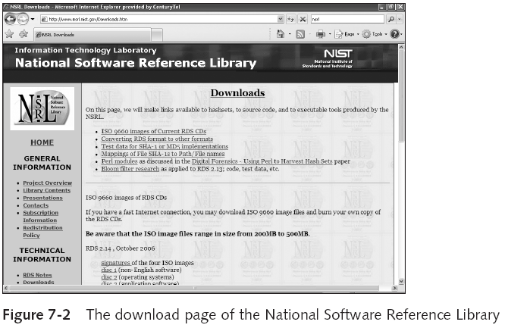
Tasks Performed by Computer Forensics Tools (continued)
Guide to Computer Forensics and Investigations

Slide 13
Tasks Performed by Computer Forensics Tools (continued)
Validation and discrimination (continued)
  Many computer forensics programs include a list of common header values
    With this information, you can see whether a file extension is incorrect for the file type
  Most forensics tools can identify header values
Guide to Computer Forensics and Investigations

Slide 14
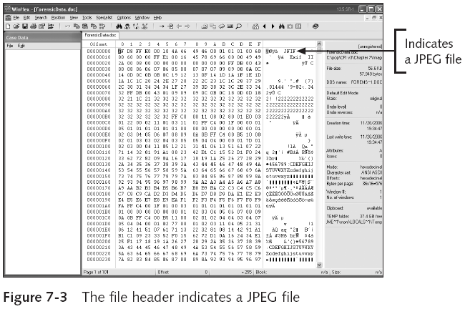
Guide to Computer Forensics and Investigations

Slide 15
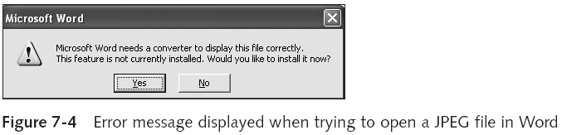
Tasks Performed by Computer Forensics Tools (continued)
Guide to Computer Forensics and Investigations

Slide 16
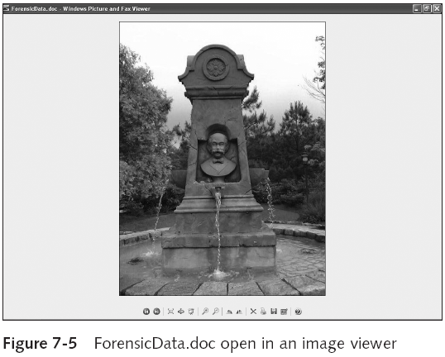
Guide to Computer Forensics and Investigations

Slide 17
Tasks Performed by Computer Forensics Tools (continued)
Extraction
  Recovery task in a computing investigation
  Most demanding of all tasks to master
  Recovering data is the first step in analyzing an investigation’s data
Guide to Computer Forensics and Investigations

Slide 18
Tasks Performed by Computer Forensics Tools (continued)
Extraction (continued)
  Subfunctions
    Data viewing
    Keyword searching
    Decompressing
    Carving
    Decrypting
    Bookmarking
  Keyword search speeds up analysis for investigators
Guide to Computer Forensics and Investigations

Slide 19
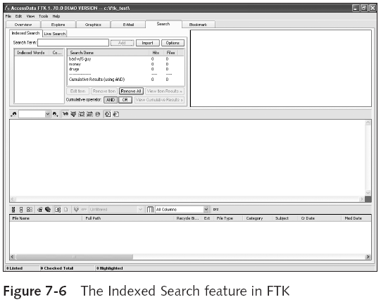
Guide to Computer Forensics and Investigations

Slide 20
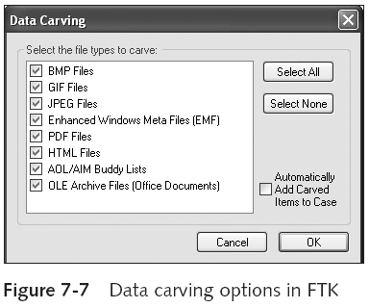
Tasks Performed by Computer Forensics Tools (continued)
Guide to Computer Forensics and Investigations

Slide 21
Tasks Performed by Computer Forensics Tools (continued)
Extraction (continued)
  From an investigation perspective, encrypted files and systems are a problem
  Many password recovery tools have a feature for generating potential password lists
    For a password dictionary attack
  If a password dictionary attack fails, you can run a brute-force attack
Guide to Computer Forensics and Investigations

Slide 22
Tasks Performed by Computer Forensics Tools (continued)
Reconstruction
  Re-create a suspect drive to show what happened during a crime or an incident
  Subfunctions
    Disk-to-disk copy
    Image-to-disk copy
    Partition-to-partition copy
    Image-to-partition copy
Guide to Computer Forensics and Investigations

Slide 23
Tasks Performed by Computer Forensics Tools (continued)
Reconstruction (continued)
  Some tools that perform an image-to-disk copy:
    SafeBack
    SnapBack
    EnCase
    FTK Imager
    ProDiscover
Guide to Computer Forensics and Investigations

Slide 24
Tasks Performed by Computer Forensics Tools (continued)
Reporting
  To complete a forensics disk analysis and examination, you need to create a report
  Subfunctions
    Log reports
    Report generator
  Use this information when producing a final report for your investigation
Guide to Computer Forensics and Investigations

Slide 25
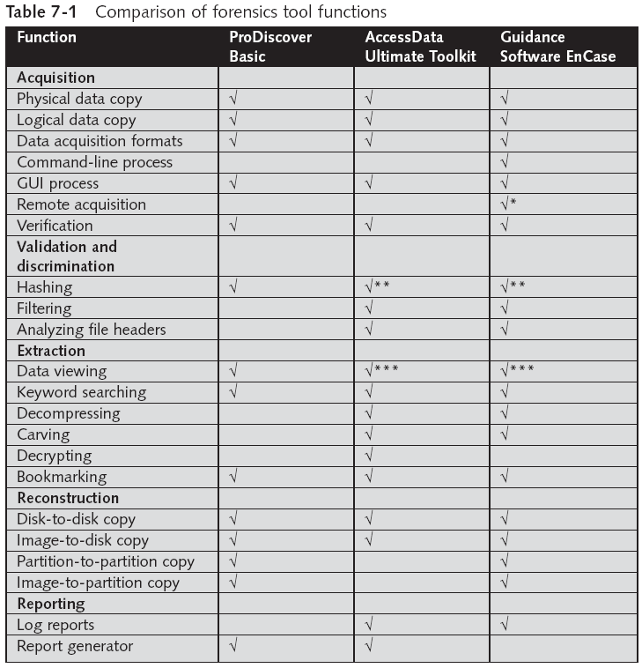
Tool Comparisons
Guide to Computer Forensics and Investigations

Slide 26
Other Considerations for Tools
Considerations
  Flexibility
  Reliability
  Expandability
  Keep a library with older version of your tools
Create a software library containing older versions of forensics utilities, OSs, and other programs
Guide to Computer Forensics and Investigations

Slide 27
Computer Forensics Software Tools
The following sections explore some options for command-line and GUI tools in both Windows and UNIX/Linux
Guide to Computer Forensics and Investigations

Slide 28
Command-line Forensic Tools
The first tools that analyzed and extracted data from floppy disks and hard disks were MS-DOS tools for IBM PC file systems
Norton DiskEdit
  One of the first MS-DOS tools used for computer investigations
Advantage
  Command-line tools require few system resources
    Designed to run in minimal configurations
Guide to Computer Forensics and Investigations

Slide 29
UNIX/Linux Forensic Tools
*nix platforms have long been the primary command-line OSs
SMART
  Designed to be installed on numerous Linux versions
  Can analyze a variety of file systems with SMART
  Many plug-in utilities are included with SMART
  Another useful option in SMART is its hex viewer
Guide to Computer Forensics and Investigations

Slide 30
UNIX/Linux Forensic Tools (continued)
Helix
  One of the easiest suites to begin with
  You can load it on a live Windows system
    Loads as a bootable Linux OS from a cold boot
Autopsy and SleuthKit
  Sleuth Kit is a Linux forensics tool
  Autopsy is the GUI/browser interface used to access Sleuth Kit’s tools
Guide to Computer Forensics and Investigations

Slide 31
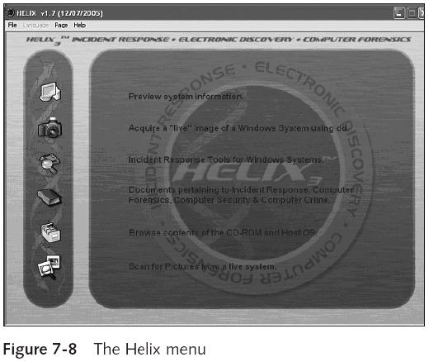
Guide to Computer Forensics and Investigations

Slide 32
UNIX/Linux Forensic Tools (continued)
Knoppix-STD
  Knoppix Security Tools Distribution (STD)
    A collection of tools for configuring security measures, including computer and network forensics
  Knoppix-STD is forensically sound
    Doesn’t allow you to alter or damage the system you’re analyzing
  Knoppix-STD is a Linux bootable CD
Guide to Computer Forensics and Investigations

Slide 33
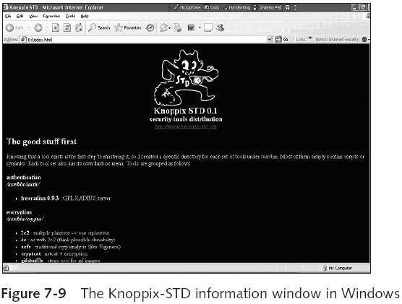
Guide to Computer Forensics and Investigations

Slide 34
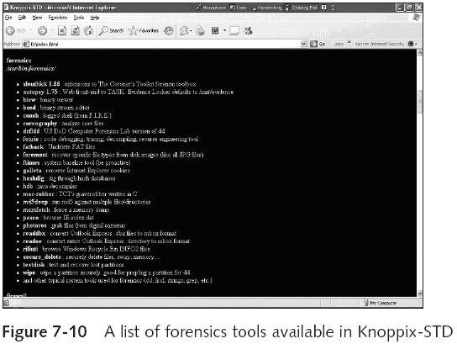
Guide to Computer Forensics and Investigations

Slide 35
Other GUI Forensic Tools
Simplify computer forensics investigations
Help training beginning investigators
Most of them come into suites of tools
Advantages
  Ease of use
  Multitasking
  No need for learning older OSs
Guide to Computer Forensics and Investigations

Slide 36
Other GUI Forensic Tools (continued)
Disadvantages
  Excessive resource requirements
  Produce inconsistent results
  Create tool dependencies
Guide to Computer Forensics and Investigations

Slide 37
Computer Forensics Hardware Tools
Technology changes rapidly
Hardware eventually fails
  Schedule equipment replacements
When planning your budget consider:
  Failures
  Consultant and vendor fees
  Anticipate equipment replacement
Guide to Computer Forensics and Investigations

Slide 38
Forensic Workstations
Carefully consider what you need
Categories
  Stationary
  Portable
  Lightweight
Balance what you need and what your system can handle
Guide to Computer Forensics and Investigations

Slide 39
Forensic Workstations (continued)
Police agency labs
  Need many options
  Use several PC configurations
Private corporation labs
  Handle only system types used in the organization
Keep a hardware library in addition to your software library
Guide to Computer Forensics and Investigations

Slide 40
Forensic Workstations (continued)
Not as difficult as it sounds
Advantages
  Customized to your needs
  Save money
Disadvantages
  Hard to find support for problems
  Can become expensive if careless
Also need to identify what you intend to analyze
Guide to Computer Forensics and Investigations

Slide 41
Forensic Workstations (continued)
You can buy one from a vendor as an alternative
Examples
  F.R.E.D.
  F.I.R.E. IDE
Having vendor support can save you time and frustration when you have problems
Can mix and match components to get the capabilities you need for your forensic workstation
Guide to Computer Forensics and Investigations

Slide 42
Using a Write-Blocker
Write-blocker
  Prevents data writes to a hard disk
Software-enabled blockers
  Software write-blockers are OS dependant
  Example: PDBlock from Digital Intelligence
Hardware options
  Ideal for GUI forensic tools
  Act as a bridge between the suspect drive and the forensic workstation
Guide to Computer Forensics and Investigations

Slide 43
Using a Write-Blocker (continued)
Can navigate to the blocked drive with any application
Discards the written data
  For the OS the data copy is successful
Connecting technologies
  FireWire
  USB 2.0
  SCSI controllers
Guide to Computer Forensics and Investigations

Slide 44
Recommendations for a Forensic Workstation
Determine where data acquisitions will take place
Data acquisition techniques
  USB 2.0
  FireWire
Expansion devices requirements
Power supply with battery backup
Extra power and data cables
Guide to Computer Forensics and Investigations

Slide 45
Recommendations for a Forensic Workstation (continued)
External FireWire and USB 2.0 ports
Assortment of drive adapter bridges
Ergonomic considerations
  Keyboard and mouse
  A good video card with at least a 17-inch monitor
High-end video card and monitor
If you have a limited budget, one option for outfitting your lab is to use high-end game PCs
Guide to Computer Forensics and Investigations

Slide 46
Validating and Testing Forensic Software
Make sure the evidence you recover and analyze can be admitted in court
Test and validate your software to prevent damaging the evidence
Guide to Computer Forensics and Investigations

Slide 47
Using National Institute of Standards and Technology (NIST) Tools
Computer Forensics Tool Testing (CFTT) program
  Manages research on computer forensics tools
NIST has created criteria for testing computer forensics tools based on:
  Standard testing methods
  ISO 17025 criteria for testing items that have no current standards
  ISO 5725
Guide to Computer Forensics and Investigations

Slide 48
Using National Institute of Standards and Technology (NIST) Tools (continued)
Your lab must meet the following criteria
  Establish categories for computer forensics tools
  Identify computer forensics category requirements
  Develop test assertions
  Identify test cases
  Establish a test method
  Report test results
Also evaluates drive-imaging tools using
  Forensic Software Testing Support Tools (FS-TST)
Guide to Computer Forensics and Investigations

Slide 49
Using National Institute of Standards and Technology (NIST) Tools (continued)
National Software Reference Library (NSRL) project
  Collects all known hash values for commercial software applications and OS files
    Uses SHA-1 to generate a known set of digital signatures called the Reference Data Set (RDS)
  Helps filtering known information
  Can use RDS to locate and identify known bad files
Guide to Computer Forensics and Investigations

Slide 50
Using Validation Protocols
Always verify your results
Use at least two tools
  Retrieving and examination
  Verification
Understand how tools work
One way to compare results and verify a new tool is by using a disk editor
  Such as Hex Workshop or WinHex
Guide to Computer Forensics and Investigations

Slide 51
Using Validation Protocols (continued)
Disk editors
  Do not have a flashy interface
  Reliable tools
  Can access raw data
Computer Forensics Examination Protocol
  Perform the investigation with a GUI tool
  Verify your results with a disk editor
  Compare hash values obtained with both tools
Guide to Computer Forensics and Investigations

Slide 52
Using Validation Protocols (continued)
Computer Forensics Tool Upgrade Protocol
  Test
    New releases
    OS patches and upgrades
  If you find a problem, report it to forensics tool vendor
    Do not use the forensics tool until the problem has been fixed
  Use a test hard disk for validation purposes
  Check the Web for new editions, updates, patches, and validation tests for your tools
Guide to Computer Forensics and Investigations

Slide 53
Summary
Create a business plan to get the best hardware and software
Computer forensics tools functions
  Acquisition
  Validation and discrimination
  Extraction
  Reconstruction
  Reporting
Maintain a software library on your lab
Guide to Computer Forensics and Investigations

Slide 54
Summary (continued)
Computer Forensics tools types
  Software
  Hardware
Forensics software
  Command-line
  GUI
Forensics hardware
  Customized equipment
  Commercial options
  Include workstations and write-blockers
Guide to Computer Forensics and Investigations

Slide 55
Summary (continued)
Tools that run in Windows and other GUI environments don’t require the same level of computing expertise as command-line tools
Always test your forensics tools
Guide to Computer Forensics and Investigations

